Slide 1
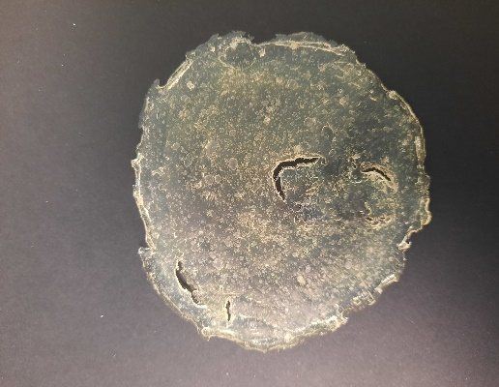
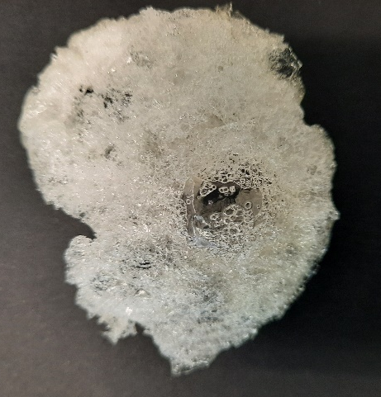
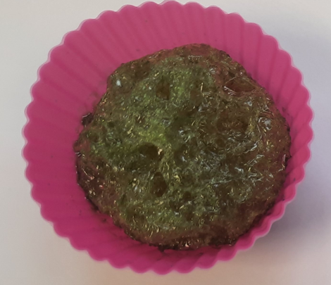
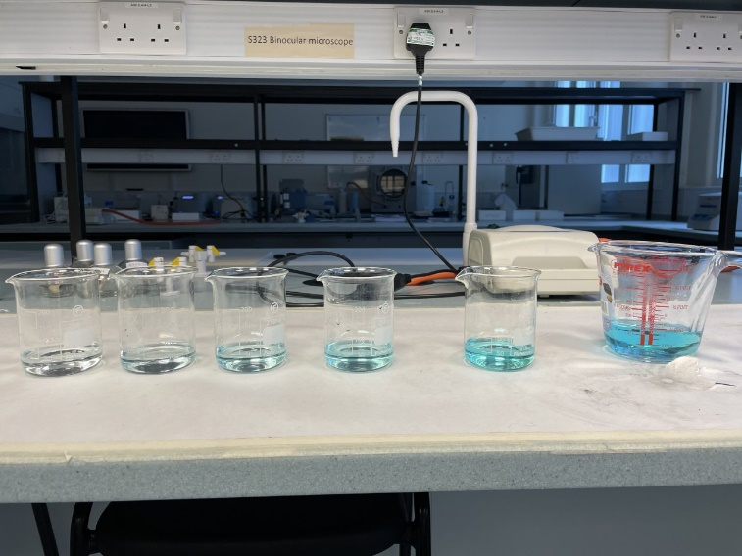
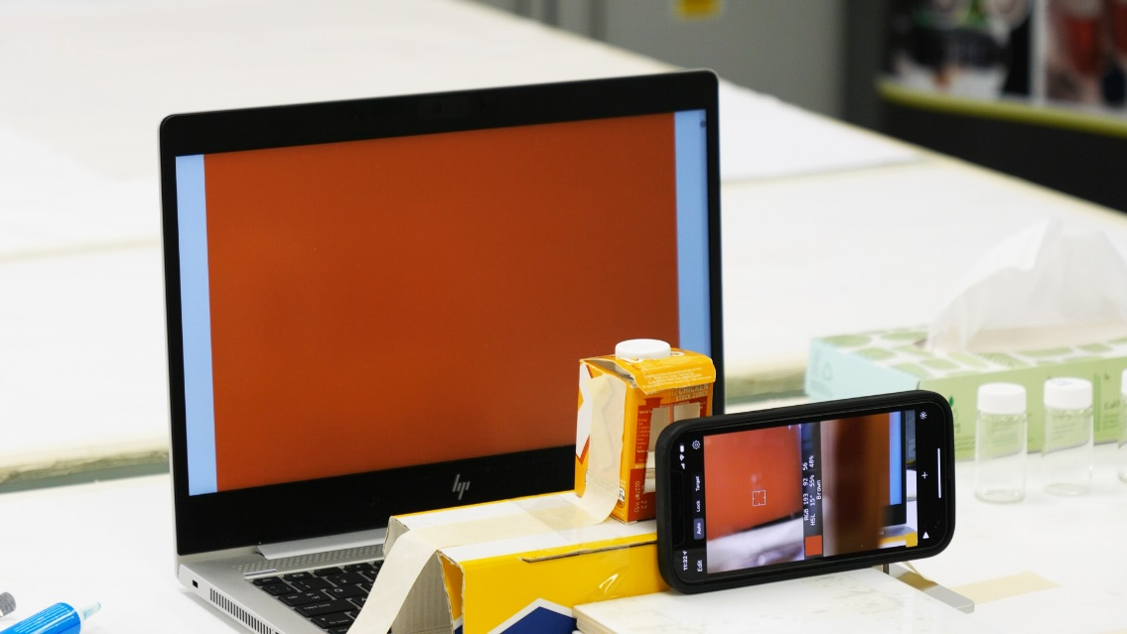
A collaborative home experiment to form bioplastics and study their degradation by monitoring the release of a dye with a smart phone
Simon Collinson*, Joanne Handford, Michael Batham, Adrian Donohogue, Matthew Kershaw, Nicholas Chatterton, Jeenat Hussain, Jasmine Pilgir, Humaira Mohammed, Josh Oakley, Matthew Cowan. Email: simon.collinson@open.ac.uk
Life, Health & Chemical Sciences, The Open University, Milton Keynes, MK7 6AA
Introduction: There’s huge interest in novel sustainable plastics due to issues with waste plastics and pollution especially following Blue Planet II. This home experiment introduces students to the synthesis of novel bioplastics using everyday renewable chemicals and then studies their degradation in alkaline solution by studying the release of an added dye.
Aims: This home experiment builds on published procedures¹⁻³ but was adapted for the UK and as a home experiment for OU students in our new module S248 Chemistry in Life.
Outline: This home experiment was run first as a pilot with three Nuffield A-level students (working at home), then with two apprentices at the Open University and a SXM390 project student (working at home). This involved:
synthesising polymers containing a food dye ^{1,2}
measuring diluted dye solutions using a Smart phone camera & App³
analysing the degradation of the polymers in alkaline solution using a Smart phone & App¹
Tutor group discussion of their findings, experimental design and experimental errors
Results: Successfully synthesised polymers from pairs of household chemicals such as starch & glycerol in a pan of hot water yields a plastic film or in a microwave to yield a polymeric foam.
Examples of plastics
i) without the food dye ii) with dye
Incorporating a blue food dye containing Brilliant Blue FCF enabled the release of this dye to be recorded on a smart phone app as the plastic degrades. A calibration graph was also generated using a pure sample of Brilliant Blue FCF.
Examples of diluted food dye and
home experiment spectrophotometer
Tutor group forum discussion was high, average number of post discussing the experiment = 61
83% of students answered the associated question in the TMA.
Conclusions: (i) used the home experiment with both Nuffield project and apprentice students.
(ii) Their data was also used for an Alternative Learning Experience.
(iii) S248 first presentation so work is ongoing to streamline the experiments and avoid minor issues noted by students and tutors.
(iv) The S248 students seem to have engaged well with the activity and forum discussions.
References
1 C M Knutson, A P Hilker, Z P Tolstyka, C B Anderson, P A Wilbon, R T Mathers, Michael T. Wentzel, Angela L. Perkins, and Jane E. Wissinger, Dyeing to Degrade: A Bioplastics Experiment for College and High School Classrooms, J. Chem. Educ., 2019, 96, 2565.
2 B Tisserat, R H O’kuru, H S Hwang, A A. Mohamed, R Holser, Glycerol Citrate Polyesters Produced Through Heating Without Catalysis, J. Appl. Polym. Sci., 2012, Vol. 125, 3429–3437
3 T. S. Kuntzleman, and E. C. Jacobson, Teaching Beer’s Law and Absorption Spectrophotometry with a Smart Phone: A Substantially Simplified Protocol, J. Chem. Educ., 2016, 93, 1249−1252.

