Slide 1
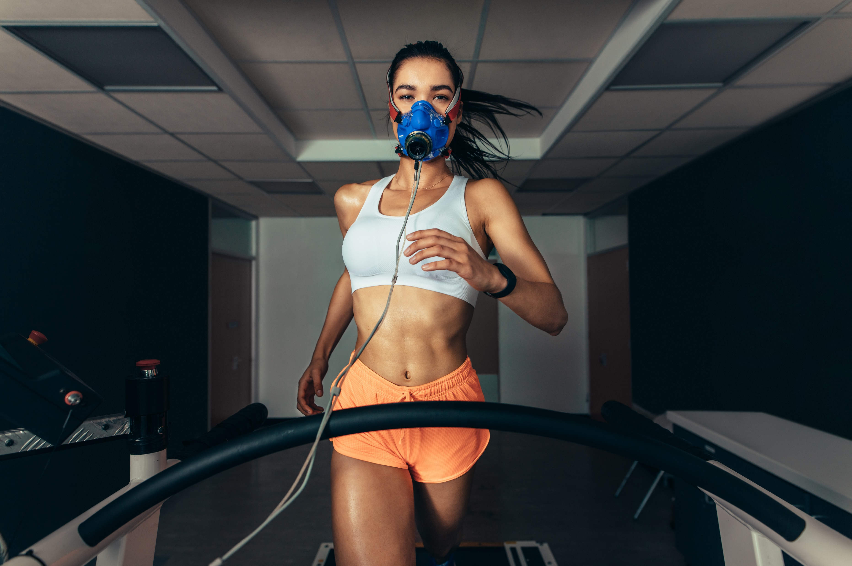
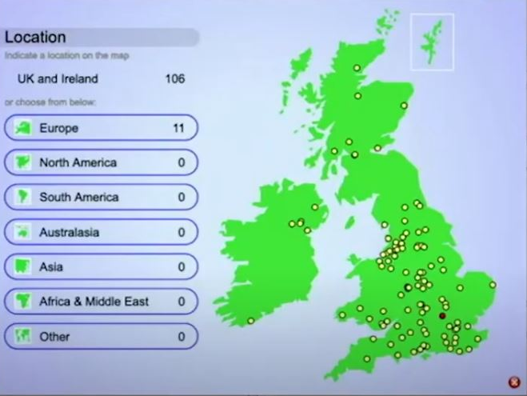
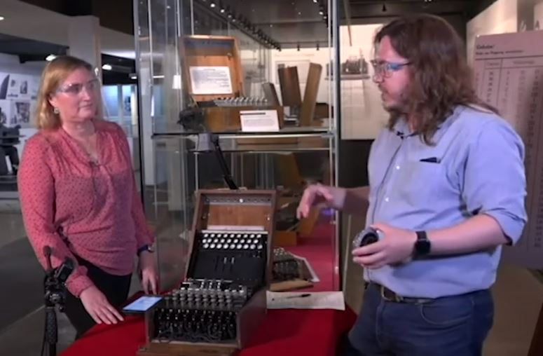
Investigating remote access to live exercise physiology testing experiments through an interactive webcast Ben Langdown, David Conway, Karen New and Vikki Hayley-Mirnar
Webcast technology:
Interactive webcasts use ‘widgets’ to allow the audience to participate and interact with onscreen presenters
Previous evidence:
Various scholarship has taken place investigating if live interactive webcasts can expose distance learners to real world environments and enhance their student experience
(Velsco, Thomson and Bradshaw 2019; Robson et al 2017; Conway, Gardner and Hughes 2021)
Research aims:
1. Assessing the use of live interactive questions (widgets) as a means of engagement and enhancing the learning experience in a live physiology webcast.
2. Investigating the impact of widget use during a live webcast on students’ ability to demonstrate data analysis in physiology testing
Project ambition:
An ambition of the SK190 Module Team and the Sport, Fitness and Coaching Qualification in WELS is to include
‘live science’
in teaching, learning and assessment
Interactive webcast technology means it may now be possible to expose distance learners to live exercise physiology tests where they must collect and analyse real data

